Slide 1
Problem-solving Using Sets - cardinality, counting subsets
Section 1.3
(sets are the basis of modern mathematics)
CSHU2833 - Logical Thinking – Faculty Of Information Technology, University of Central Punjab, Lahore
Notes:
THIS LECTURE STARTS WITH SLIDE 14

Slide 2
Some Common sets in mathematics
Natural Numbers or Counting Numbers | N = {1, 2, 3, 4, 5, ... }
Whole Numbers | W = {0, 1, 2, 3, 4, 5, ... }
Integers | I = { ..., -4, -3, -2, -1, 0, 1, 2, 3, 4, ... }
Rational Numbers | Q = the set of all terminating or repeating decimals
Irrational Numbers | R \ Q = the set of all nonterminating, nonrepeating decimals
Real Numbers | R = the set formed by combining the rational numbers and the irrational numbers
Notes:
REVISION SLIDE (FROM LECTURE 10)
The set of natural numbers is also called the set of counting numbers.
The three dots are called an ellipsis and indicate that the elements of the set continue in a manner suggested by the elements that are listed.
The integers …, -4, -3, -2, -1 are negative integers. The integers 1,2,3, are positive integers.
Note that the natural numbers and the positive integers are the same set of numbers.
The integer zero is neither a positive nor a negative integer.
If a number in decimal form terminates or repeats a block of digits, then the number is a rational number.
Rational numbers can also be written in the form where p and q are integers and q<> 0.

Slide 3
The Empty Set, Ø or {}
The set with no elements.
How many natural numbers that are less than zero?
What is the cardinal number of the empty set, n(Ø) ?
What is the complement of the empty set?
What is the complement of the universal set?
Notes:
REVISION SLIDE (FROM LECTURE 10)

Slide 4
Visualizing sets with venn diagrams
U
What set is represented by A’?
A
What set is represented by (A’)’ ?
Notes:
REVISION SLIDE (FROM LECTURE 10)

Slide 5
Intersection of sets
The intersection of sets A and B, denoted by A ∩ B is the set of elements common to both A and B.
U
A
B
A ∩ B
Notes:
REVISION SLIDE (FROM LECTURE 10)

Slide 6
Disjoint sets - nothing in the Intersection
Two sets A and B are said to be disjoint if their intersection A ∩ B is an empty set, that is, if there are no elements common to both sets.
U
A
B
A ∩ B = Ø
Notes:
REVISION SLIDE (FROM LECTURE 10)

Slide 7
Mixing them up - UNION of sets
The union of sets A and B, denoted by A ⋃ B is the set that contains all the elements that belong to both A or B or both.
U
A
B
A ⋃ B
Notes:
REVISION SLIDE (FROM LECTURE 10)

Slide 8
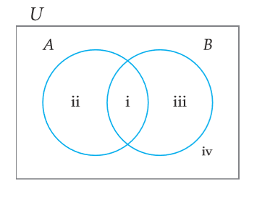
De Morgan's laws
(A ⋃ B)’ = A’ ⋂ B’ ?
(A ⋂ B)’ = A’ ⋃ B’ ?
Notes:
REVISION SLIDE (FROM LECTURE 10)

Slide 9
Checking set equality with venn diagrams
(A ⋃ B)’ = A’ ⋂ B’ ?
Regions identified:
A ⋃ B includes regions i, ii and iii
(A ⋃ B)’ includes region iv
A’ includes regions iii and iv
B’ includes regions ii and iv
A’ ⋂ B’ also includes regions iv
Hence (A ⋃ B)’ = A’ ⋂ B’
Notes:
REVISION SLIDE (FROM LECTURE 10)

Slide 10
Class activity: Checking set equality with venn diagrams
Can you prove that (A ⋂ B)’ = A’ ⋃ B’ ?
Notes:
REVISION SLIDE (FROM LECTURE 10)

Slide 11
De Morgan's laws
(A ⋃ B)’ = A’ ⋂ B’
(A ⋂ B)’ = A’ ⋃ B’
Notes:
REVISION SLIDE (FROM LECTURE 10)

Slide 12
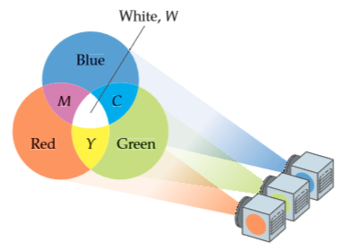
Additive Colour Mixing
Computers and televisions make use of additive colour mixing. The figure shows that when the primary colours red R, green G, and blue B are all three mixed together using additive colour mixing, they produce white, W.
Using set notation, we state this as R ⋂ G ⋂ B = W.
The colours yellow Y, cyan C, and magenta M are called secondary colours.
A secondary colour is produced by mixing exactly two of the primary colours.
Notes:
REVISION SLIDE (FROM LECTURE 10)

Slide 13
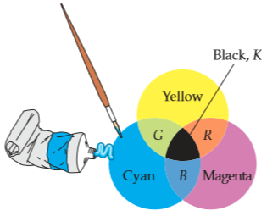
Subtractive Colour Mixing
Artists who paint with pigments use subtractive colour mixing to produce different colours.
In a subtractive colour mixing system, the primary colours are cyan C, magenta M, and yellow Y.
The figure shows that when the three primary colours are mixed in equal amounts using subtractive colour mixing, they form black, K.
Using set notation, we state this as C ⋂ M ⋂ Y = K
In subtractive colour mixing, the colours red R, blue B, and green G are called secondary colours.
A secondary colour is produced by mixing equal amounts of exactly two of the primary colours.
Notes:
REVISION SLIDE (FROM LECTURE 10)

Slide 14
Intersection and union of sets - Cardinality formula
n(A ⋃ B) = n(A) + n(B) – n(A ⋂ B)
Can you use a Venn diagram to support this formula with logical arguments?
Notes:
FIRST SLIDE OF LECTURE 11

Slide 15
Intersection and union of sets - Cardinality formula
n(A ⋃ B) = n(A) + n(B) – n(A ⋂ B)
If n (A) = 30, n (B) = 20, and n (A ⋂ B) = 5 , find n (A ⋃ B) .
If n(A ⋃ B) = 60, n(A) = 40, and n(A ⋂ B) = 8, find n (B) .
If n(A ⋃ B) = n(A) + n(B), what must be the relationship
between sets A and B?

Slide 16
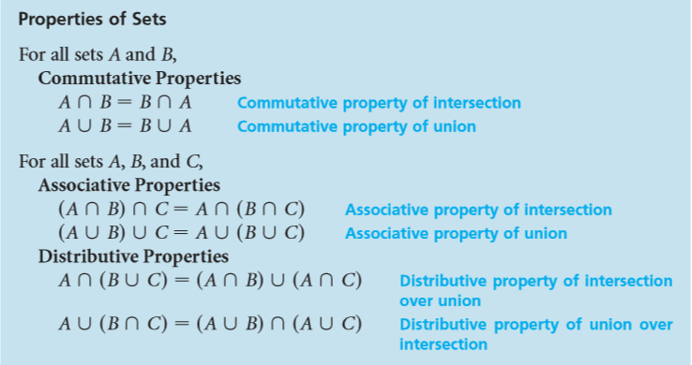
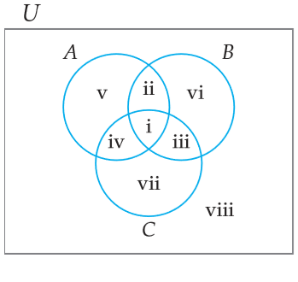
Class Activity: Verify the Properties of sets
Notes:
Prompt the students to use the same methods as they used to prove De Morgan’s Laws.

Slide 17
Organizing survey results
A survey of people about their tastes in films shows that:
695 people like action adventure films
340 people like comedies
180 people like both action adventure as well as comedy films
Of the people surveyed, how many people like:
action adventure but not comedy films?
comedy films but not action adventures?
neither of these two kinds of films?

Slide 18
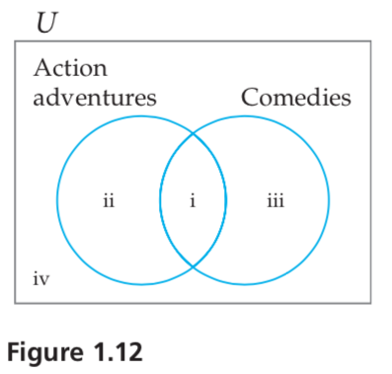
Organizing survey results
A survey of 1000 people about their tastes in films shows that:
695 people like action adventure films
340 people like comedies
180 people like both action adventure as well as comedy films
Of the people surveyed, how many people like:
action adventure but not comedy films?
comedy films but not action adventures?
neither of these two kinds of films?
??
180
??
??
Notes:
Prompt the students to think how many people are in region ii and how many people are in region iii
Prompt them to figure out how many people are in regions i, ii and iii combined.
This should allow them to figure out how many people are in region iv, that is, those who like neither action adventures nor comedies.

Slide 19
analyzing research results
Of all the athletes who were treated for minor back pain,
72% responded to an analgesic,
59% responded to a muscle relaxant, and,
44% responded to both forms of treatment.
What percent of the athletes who were treated responded to the muscle relaxant but not to the analgesic?
What percent of the athletes who were treated did not respond to either form of treatment?

Slide 20
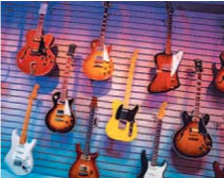
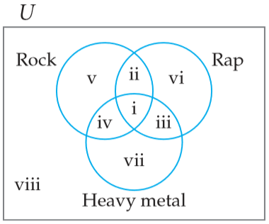
analyzing research results
A music teacher has surveyed 495 students. The results of the survey are listed below:
320 students like rap music.
395 students like rock music.
295 students like heavy metal music.
280 students like both rap music and rock music.
190 students like both rap music and heavy metal music.
245 students like both rock music and heavy metal music.
160 students like all three.
How many students:
a. like exactly two of the three types of music?
b. like only rock music?
c. like only one of the three types of music?

Slide 21
analyzing research results
A music teacher has surveyed 495 students. The results of the survey are listed below:
320 students like rap music. {i, ii, iii, vi}
395 students like rock music. {i, ii, iv, v}
295 students like heavy metal music. {i, iii, iv, viii}
280 students like both rap music and rock music. {i + ii}
190 students like both rap music and heavy metal music. {i + iii}
245 students like both rock music and heavy metal music. {i + iv}
160 students like all three. {i}
How many students:
a. like exactly two of the three types of music?
b. like only rock music?
c. like only one of the three types of music?
280 – 160 = 120
160
?? - 160
?? - 160
Notes:
For each data point, map it to the relevant set of regions in the Venn diagram.
Use the mapping to calculate how many like only rock and rap, how many like only heavy metal and rap and how many like heavy metal and rock. Then add up these numbers.
n(v) = 395 – n(ii) – n(i) – n(iv)
Calculate n(vii) and n(vi). Answer is n(v) + n(vii) + n(vi)

Slide 22
A tasty problem
A restaurant provides a brunch where the omelets are individually prepared. Each guest is allowed to choose from 10 different ingredients.
How many different types of omelets can the restaurant prepare?
What is the minimum number of ingredients that must be available if the restaurant wants to advertise that it offers over 4000 different omelets?
Notes:
Let the students attempt this problem for a minute.
Most will be confused as to how to attempt it.
Move on without solving it.

Slide 23
Counting in politics
Five people, designated A, B, C, D, and E, serve on a committee. To pass a motion, at least three of the committee members must vote for the motion.
In such a situation, any set of three or more voters is called a winning coalition because if this set of people votes for a motion, the motion will pass.
Any nonempty set of two or fewer voters is called a losing coalition.
List all the winning coalitions.
List all the losing coalitions.
Notes:
Let the students attempt this problem for a minute.
Most will be confused as to how to attempt it.
Move on without solving it.
Just mention that they will get a chance to solve it after learning about subsets…

Slide 24
subsets
What is common operation in the following examples?
Only those Nobel laureates who were born in Iran, Pakistan or India
Students in the class with grey eyes
Vowels in the English alphabet

Slide 25
Subsets - ⊆
Set A is a subset of set B,
denoted by A ⊆ B,
if and only if every element of A is also an element of B.
Express in set notation:
A set is always a subset of itself.
The empty set is a subset of any set.
Notes:
Solution:
A ⊆ A, for any set A
Ø ⊆ A, for any set A

Slide 26
subsets
Express in set notation:
A set is always a subset of itself: A ⊆ A, for any set A
The empty set is a subset of any set: Ø ⊆ A, for any set A

Slide 27
subsets
True or False?
{2, 5} ⊆ {2, 4, 6}
{2, 4, 5} ⊆ {2, 4, 5}
W ⊆ N
Ø ⊆ {1, 2, 30, 7}

Slide 28
subsets
True or False?
The set of counting numbers is a subset of the set of natural numbers.
Ø ⊆ U

Slide 29
Subsets – Negation – ⊄
When you want to say that a set is NOT a subset of another set.
True of False?
W ⊄ N
{spring, summer, monsoon, fall, smog, winter} ⊄ {spring, summer, cyclone season}

Slide 30
Proper subset
Set A is a proper subset of set B, denoted by A ⊂B, if every element of A is an element of B, and A ≠ B.
Let R = {Mars, Venus} and S = {Mars, Venus, Mercury}.
The first set R is a subset of the second set S because every element of R is an element of S. In addition, R is also a proper subset of S, because R ≠ S.
Let T ={Europe, Africa} and V = {Africa, Europe}.
The first set T is a subset of the second set V; however, T is not a proper subset of V because T = V.

Slide 31
Number of Subsets of a set
List all the subsets of:
{a, b, c}
{1, 2, 3, 4}

Slide 32
Number of Subsets of a set
Make an Organized List all the subsets of:
{a, b, c}
Kinds of subsets (based on cardinality) | Count of each kind
Subsets of 1 element each: {a}, {b}, {c} | 3
Subsets of 2 elements each: {a, b}, {b, c}, {a, c} | 3
Subsets of 3 elements each: {a, b, c} | 1
Subsets of 0 elements: {} | 1
Total subsets: | 8

Slide 33
Counting the subsets of {a, b, c}
Looking at our solution another way – as a truth table:
a | b | c | Subset
Y | Y | Y | {a, b, c}
Y | Y | N | {a, b}
Y | N | Y | {a, c}
N | Y | Y | {b, c}
N | N | Y | {c}
N | Y | N | {b}
Y | N | N | {a}
N | N | N | {}
Count of Subsets: |  |  | 8

Slide 34
Can you guess the number of subsets of {1, 2, 3, 4} ?

Slide 35
Counting the subsets of {1, 2, 3, 4}
1 | 2 | 3 | 4 | Subset
Y | Y | Y | N | {1, 2, 3}
Y | Y | N | N | {1, 2}
Y | N | Y | N | {1, 3}
N | Y | Y | N | {2, 3}
N | N | Y | N | {3}
N | Y | N | N | {2}
Y | N | N | N | {1}
N | N | N | N | {}
Count WITHOUT ELEMENT "4": |  |  |  | 8

Slide 36
Counting the subsets of {1, 2, 3, 4}
1 | 2 | 3 | 4 | Subset
Y | Y | Y | Y | {1, 2, 3, 4}
Y | Y | N | Y | {1, 2, 4}
Y | N | Y | Y | {1, 3, 4}
N | Y | Y | Y | {2, 3, 4}
N | N | Y | Y | {3, 4}
N | Y | N | Y | {2, 4}
Y | N | N | Y | {1, 4}
N | N | N | Y | {4}
Count WITH ELEMENT "4" |  |  |  | 8

Slide 37
So, the number of subsets of {1, 2, 3, 4} ?

Slide 38
Is there a pattern?
Size of set | Number of subsets
0 | 1
1 | 2
2 | 4
3 | 8
4 | 8+8=16
5 | 16+16=32

Slide 39
Number of subsets of a set
How can we check this claim?
“A set with n elements has 2^{n} subsets and 2^{n} - 1 proper subsets.”

Slide 40
the pattern?
Size of set | Number of subsets | Number of subsets
0 | 1 | 2⁰
1 | 2 | 2¹
2 | 4 | 2²
3 | 8 | 2³
4 | 16 | 2⁴
5 | 32 | 2⁵
… | … | …
n |  | 2^{n}

Slide 41
Can you give a deductive argument to explain this pattern?
Element | 1st element | 2nd element | 3rd element | … | (n-1)^{th} element | n^{th} element
Is Present in subset? | Yes/No | Yes/No | Yes/No | … | Yes/No | Yes/No
No. of Options | 2 | 2 | 2 | … | 2 | 2
Size of set | Number of subsets | Number of subsets
0 | 1 | 2⁰
1 | 2 | 2¹
2 | 4 | 2²
3 | 8 | 2³
4 | 16 | 2⁴
5 | 32 | 2⁵
… | … | …
n |  | 2^{n}
So, total number of possibilities:
2 x 2 x 2 x … x 2 x 2 = 2 x 2, n times… that is … ?
Notes:
It would be helpful to illustrate the meaning of the table on the left with actual examples by counting the number of subsets of a set with 2 elements and of a set with 3 elements.

Slide 42
A tasty problem - Counting subsets
A restaurant provides a brunch where the omelets are individually prepared. Each guest is allowed to choose from 10 different ingredients.
How many different types of omelets can the restaurant prepare?
What is the minimum number of ingredients that must be available if the restaurant wants to advertise that it offers over 4000 different omelets?
Notes:
2^10
Ceiling(log_base_2(4000)) = 12

Slide 43
Counting in politics - Counting subsets
Winning Coalition | Sum of Votes
{A, B, C} | 3
{A, B, D} | 3
{A, B, E} | 3
{A, C, D} | 3
{A, C, E} | 3
{A, D, E} | 3
{B, C, D} | 3
{B, C, E} | 3
{B, D, E} | 3
{C, D, E} | 3
{A, B, C, D} | 4
{A, B, C, E} | 4
{A, B, D, E} | 4
{A, C, D, E} | 4
{B, C, D, E} | 4
{A, B, C, D, E} | 5
Five people, designated A, B, C, D, and E, serve on a committee. To pass a motion, at least three of the committee members must vote for the motion.
In such a situation, any set of three or more voters is called a winning coalition because if this set of people votes for a motion, the motion will pass.
Any nonempty set of two or fewer voters is called a losing coalition.
List all the winning coalitions.
List all the losing coalitions.

Slide 44
Counting in politics - Counting subsets
Winning Coalition | Sum of Votes | Losing Coalition
{A, B, C} | 3 | {D, E}
{A, B, D} | 3 | {C, E}
{A, B, E} | 3 | …
{A, C, D} | 3 | …
{A, C, E} | 3
{A, D, E} | 3
{B, C, D} | 3
{B, C, E} | 3
{B, D, E} | 3
{C, D, E} | 3
{A, B, C, D} | 4
{A, B, C, E} | 4
{A, B, D, E} | 4
{A, C, D, E} | 4
{B, C, D, E} | 4
{A, B, C, D, E} | 5 | --
Five people, designated A, B, C, D, and E, serve on a committee. To pass a motion, at least three of the committee members must vote for the motion.
In such a situation, any set of three or more voters is called a winning coalition because if this set of people votes for a motion, the motion will pass.
Any nonempty set of two or fewer voters is called a losing coalition.
List all the winning coalitions.
List all the losing coalitions.

Slide 45
Counting in politics - Counting subsets – 2
A weighted voting system is one in which some voters’ votes carry more weight regarding the outcome of an election. For example, a selection committee consists of four people, designated by A, B, C, and D. Voter A’s vote has a weight of 2, and the vote of each other member of the committee has a weight of 1.
A winning coalition must have a weighted voting sum of at least 3.
Any nonempty set of with a weighted voting sum of 2 or less is called a losing coalition.
List all the winning coalitions.
List all the losing coalitions.
Winning Coalition | Sum of Votes
{A, B} | 3
{A, C} | 3
{A, D} | 3
{B, C, D} | 3
{A, B, C} | 4
{A, D, E} | 4
{A, B, D} | 4
{A, C, D} | 4
{A, B, C, D} | 5

Slide 46
Counting in politics - Counting subsets – 2
A minimal winning coalition is a winning coalition that has no proper subset that is a winning coalition.
In a minimal winning coalition, each voter is said to be a critical voter because if any of the voters leaves the coalition, the coalition will then become a losing coalition.
Identify the minimal winning coalitions in this table.
Winning Coalition | Sum of Votes
{A, B} | 3
{A, C} | 3
{A, D} | 3
{B, C, D} | 3
{A, B, C} | 4
{A, D, E} | 4
{A, B, D} | 4
{A, C, D} | 4
{A, B, C, D} | 5

Slide 47
Questions for training and assessment

